Slide 1
Business Barometer Survey 2019
Key Findings
May 2019
Mill House
North Street
York , YO1 6JD
Tel: 01904 632039

Slide 2
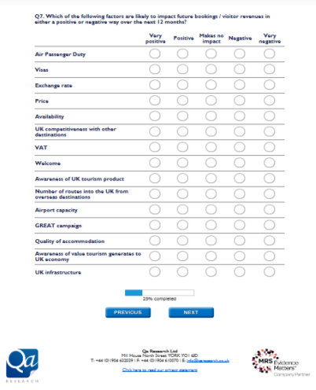
Aims & method
Business barometer survey of members
The aims of the barometer are to:
Understand how different membership sectors are performing
Determine the level of business generated by membership
Inform lobbying & PR activity
Enable UKinbound to react to industry developments more quickly, by gathering feedback on current issues impacting the tourism industry
Online survey sent to members May 2019
51 members completed the survey
Many thanks for taking part!

Slide 3
Varied mix of sectors took part
Q1. Which membership category do you fall into? Base: 51

Slide 5
More than 2 in 5 (41%) had increased business
In March and April ’19 compared with the same months in ‘18
with bookings/visitor numbers/customer orders
On average, orders INCREASED by 26%
On average, orders DECREASED by
17%
Solid increases for service providers:
Nearly two-thirds (62%) service providers saw increased bookings
Mixed fortunes for Tour Operators:
While 45% saw an increase in bookings, over a third (36%) saw decreases
Q2. Compared with March and April in 2018, were your bookings / visitor numbers / customer orders for the same period in 2019: higher, about the same or lower? Base: 51

Slide 6
Why did your bookings/visitor numbers/orders increase?
“Good weather over the Easter
weekend”- Destination
“Due to the decline in French business we have been actively pushing the long haul markets”
- Tour Operator
“Key destinations (London, Edinburgh) continue to remain attractive, especially due to affordability.”
- Tour Operator
“Stronger midweek group business”
- Service Provider
“January to April were particularly poor for us in 2018 - Beast from the East, Snow, etc.” - Attraction
Q2b. Why did your bookings/visitor numbers/orders increase? Base 21

Slide 7
Why did your bookings/visitor numbers/orders decrease?
“A number of factors, including uncertainty around Brexit and the economy as well as poor on-field team performance.”
- Attraction
“The tours series from our client in Europe are fully booked, clients are starting their trips in Paris instead of London.”
- Tour Operator
“Less European speaking candidates available. Improved technology and relocation of some clients to Europe have decreased number of job opportunities.” - Service Provider
“More cancellations as a result of BREXIT”
- Accommodation
Q2d. Why did your bookings/visitor numbers/orders decrease? Base: 13

Slide 8
Well over a third (37%) increased revenue yield
In March & April ‘19 compared with the same months in ‘18
On average, yield rev INCREASED by
25%
On average, yield rev DECREASED by
15%
Mixed fortunes for TOs:
While 41% reported increases, 27% saw no change, and nearly a third (32%) saw a drop in revenue
Service providers largely prospering:
Over half (54%) increased yield, 38% remained static. Only 8% saw a decrease
Q3. Compared with March and April 2018, was your revenue yield for the same period in 2019: higher, about the same or lower? Base: 51

Slide 9
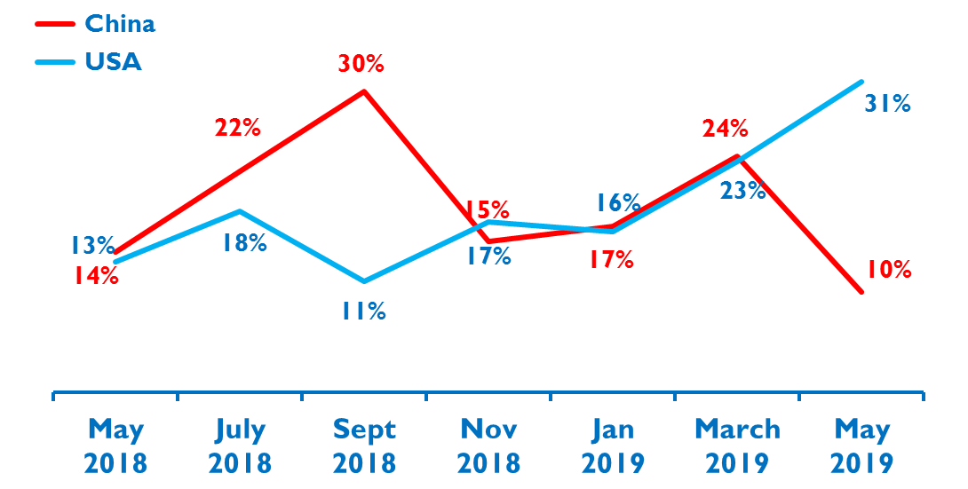
Steady growth from USA market, while China drops
29%
Not experiencing growth from any overseas markets
Q4. Select the main market that you are currently experiencing growth in. Base: 51

Slide 10
German & French markets show greatest decline
45%
Not experiencing decline from any overseas markets.
22%
Experienced decline from German market
12%
Experienced decline from French market
Q5. Select the main market that you are currently experiencing decline in. Base: 51

Slide 11
Confidence in future business levels drops slightly
Q6. Looking ahead to the next 12 months, how confident are you feeling about bookings / visitor revenues / customer orders? Base: 51

Slide 12
Strong bookings & domestic growth spark confidence in coming year
“We are confident in the long haul markets which are strong and showing an increase in bookings.”
Tour Operator
“Forward bookings looking strong”
Service Provider
“Due to growth in domestic visitors.”
Attraction
“We have already surpassed our total turnover for 2018.”
Tour Operator
“Destination busier”
Service Provider
Q6a. Why do you feel confident about bookings/visitor numbers/customer orders for the next 12 months? Base: 25

Slide 13
‘Brexit’ concerns dominate low & uncertain confidence
“Brexit concerns are still ongoing and will we be weather dependent. School budget cuts is still a concern and has affected volume & revenue”
Attraction
“Mostly because of Brexit; this year has been very unpredictable so far.”
Tour Operator
“BREXIT uncertainty is continuing / Economy uncertain.”
Accommodation Provider
“Brexit uncertainty - it could cause massive problems for us operationally.”
Service Provider
Q6a. Why do you feel less confident about bookings/visitor numbers/customer orders for the next 12 months? Base: 26

Slide 14
55%
agree sharing economy platforms (e.g. Uber, Airbnb) should be subject to tourism regulations…
…only 2% disagreed with this, the remaining 43% were neutral or not applicable
Q7. To what extent do you agree that there should be more regulation of sharing economy platforms? Base: 51

Slide 15
Consumer & sector protection drives desire for regulation
Q7a. Why do you feel sharing economy platforms should be subject to the same regulations as other tourism providers? Base: 28

Slide 16
This research has been carried out in compliance with
ISO 20252, (the International Standard for Market and Social research),
The Market Research Society’s Code of Conduct and UK Data Protection law.
Contact ... Richard Bryan richard.bryan@qaresearch.co.uk www.qaresearch.co.uk
Qa Research, Mill House, North Street, York ,YO1 6JD
Tel: 01904 632039
Qa Research is a trading name of QA Research Ltd, UK registered, company registration number 3186539, address in York as above.

